Slide 1
Start with ifcSQL_Tools

Slide 2
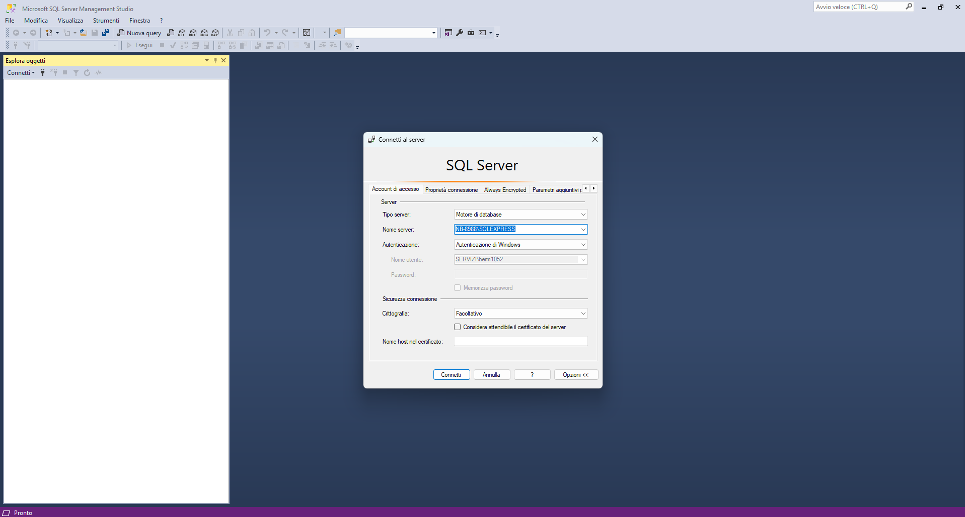
Microsoft SQL server (MSSQL) and SQL Server Management Studio (SSMS)
Download and install:
Microsoft SQL Server Express 22 (https://www.microsoft.com/it-it/download/details.aspx?id=104781)
SQL Server Management Studio 20 (https://learn.microsoft.com/it-it/ssms/release-notes-20)

Slide 3
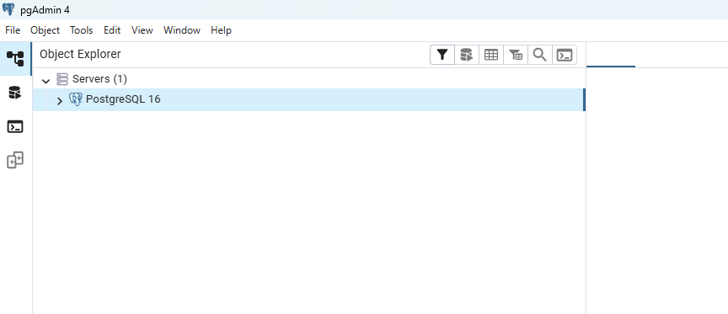
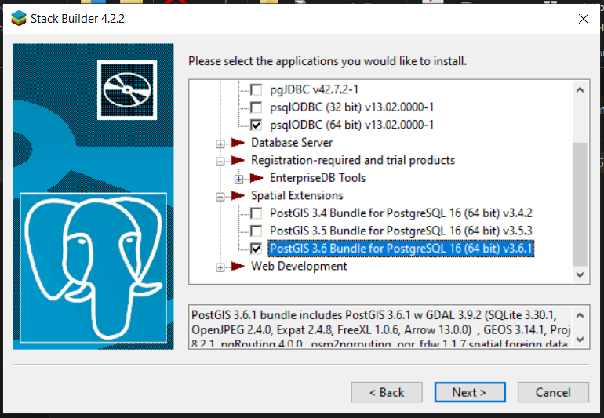
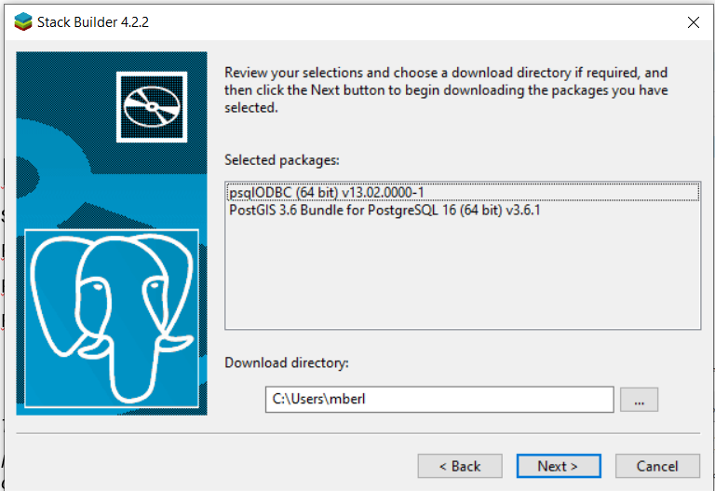
PostgreSQL + pgadmin
Download and install:
- PostgreSQL 16
- Pgadmin
- PostGIS
Download and install everthing together:
https://www.enterprisedb.com/downloads/postgres-postgresql-downloads

Slide 4
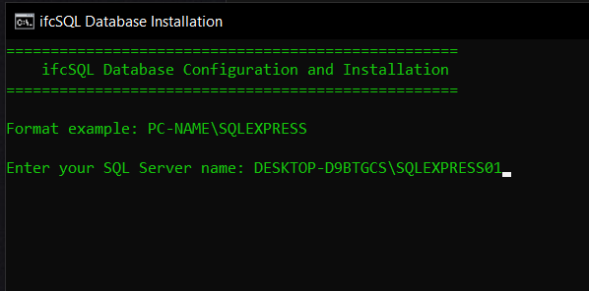
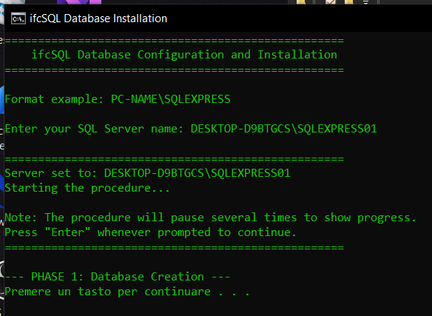
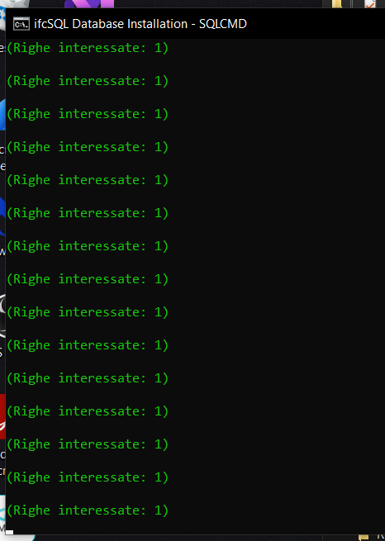
1.ifcSQL_Installation_MSSQL.bat
Use the «ifcSQL_Installation_MSSQL» to install ifcSQL into MSSQL
Press a key until the process is finish
The process may take some minutes

Slide 5
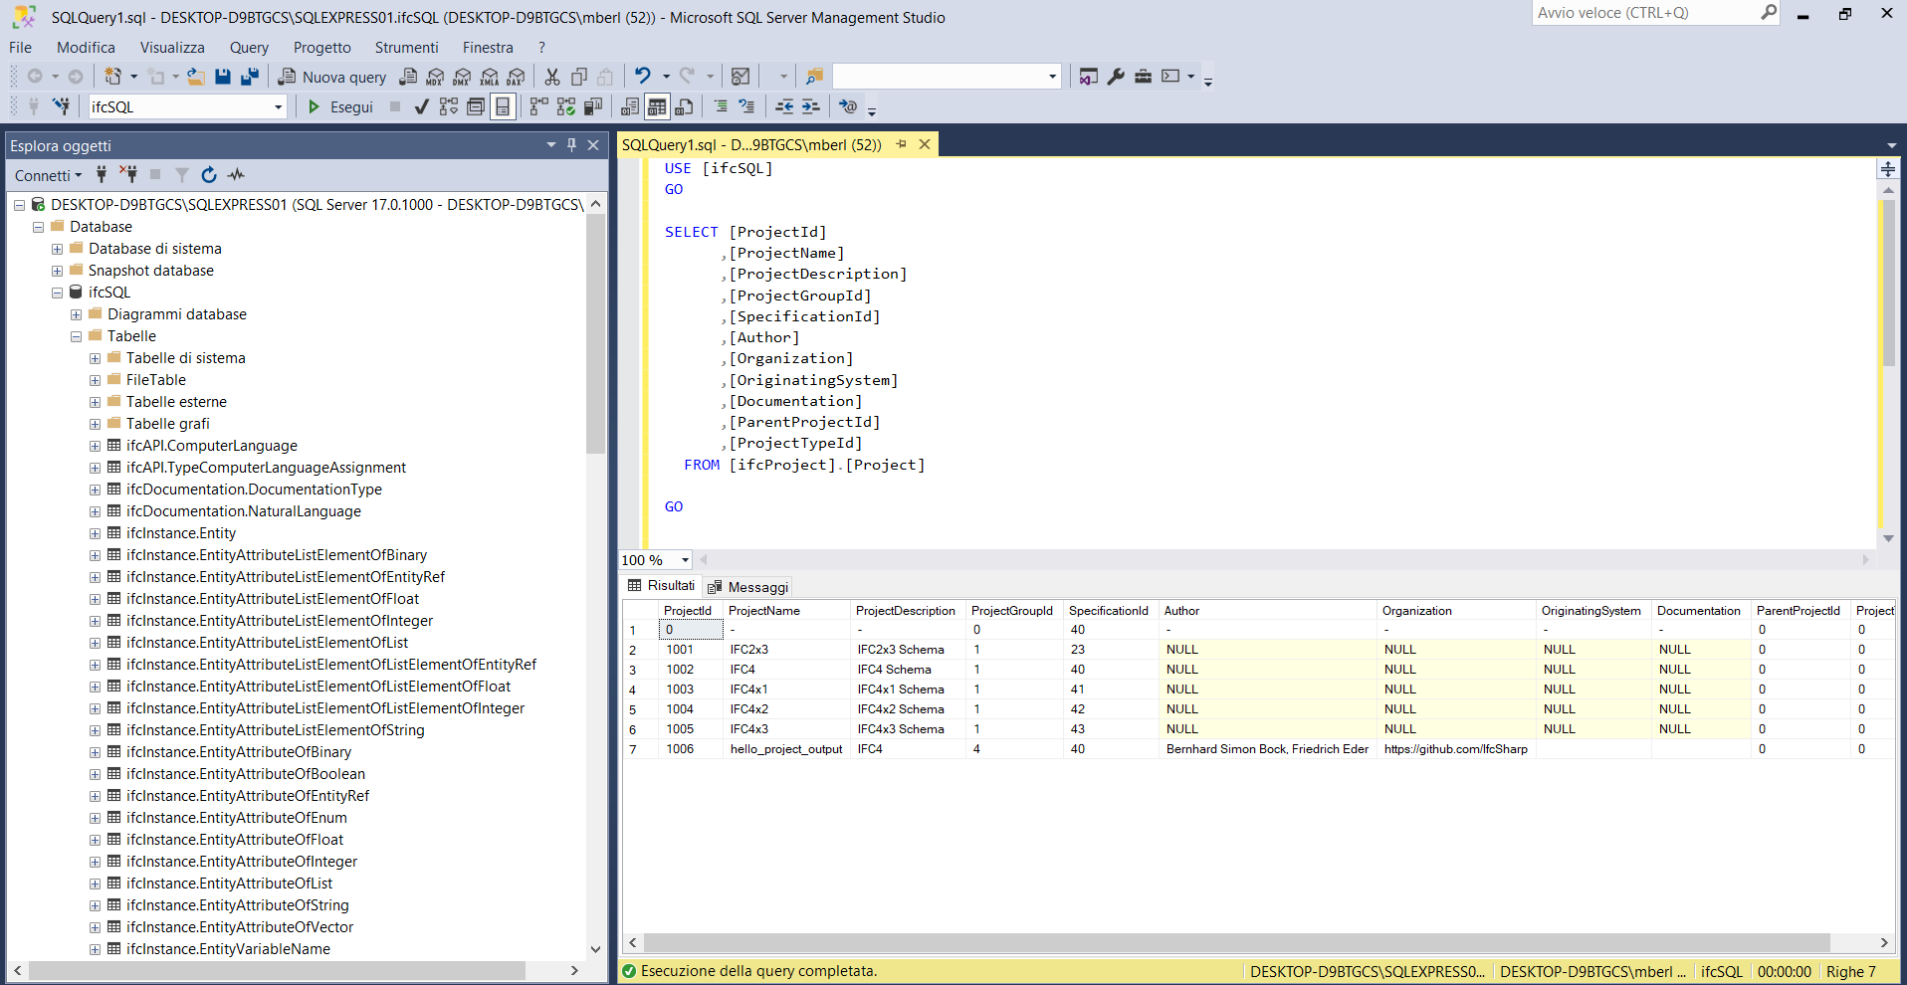
Database generated successfully

Slide 6
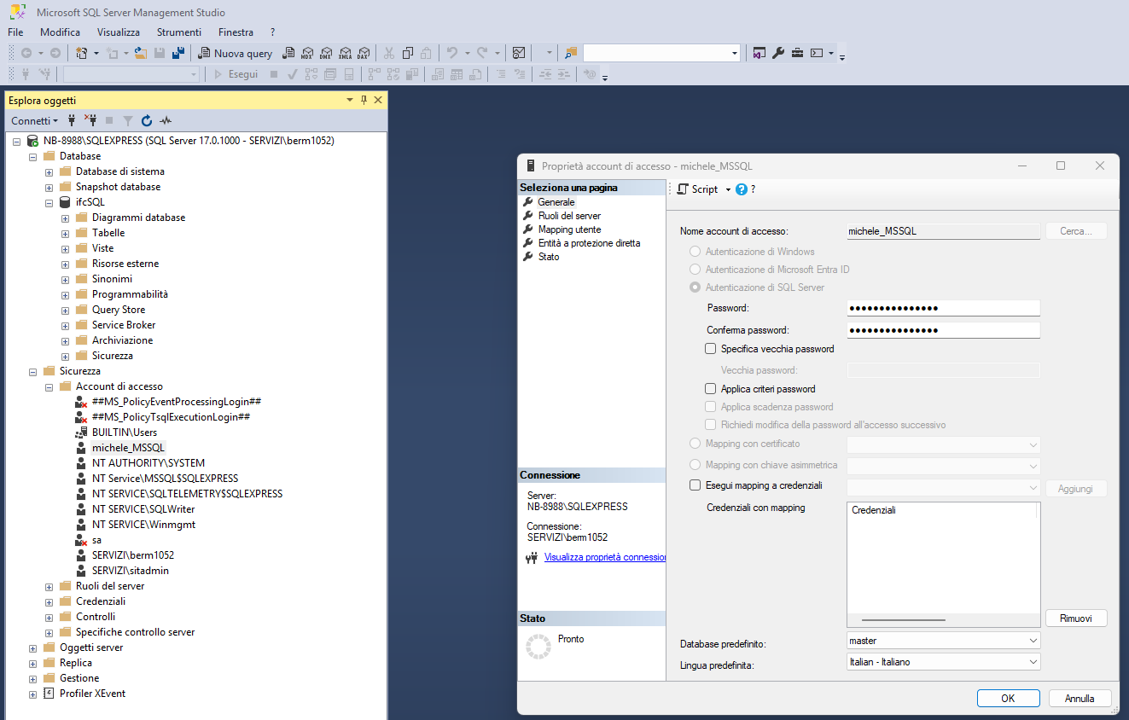
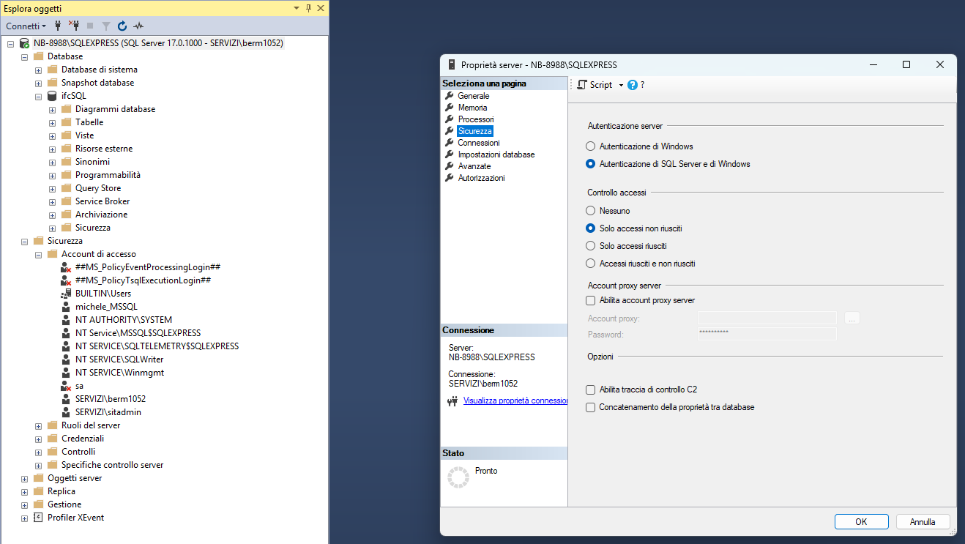
Create a USER in MSSQL
Follow the «2.Create a user in MSSQL» guideline.
Summary of the step:
Create an MSSQL user with SQL server authentication and password.
Give the user administrator privileges.
Set up access with mixed authentication (SQL server + Windows).
Verify that the user can log in to MSSQL.

Slide 7
3.ifcSQL_Installation_PostgreSQL.bat
Use the «3.ifcSQL_Installation_PostgreSQL» to install ifcSQL in PostgreSQL.
Follow the instruction in the bat.

